Slide 1
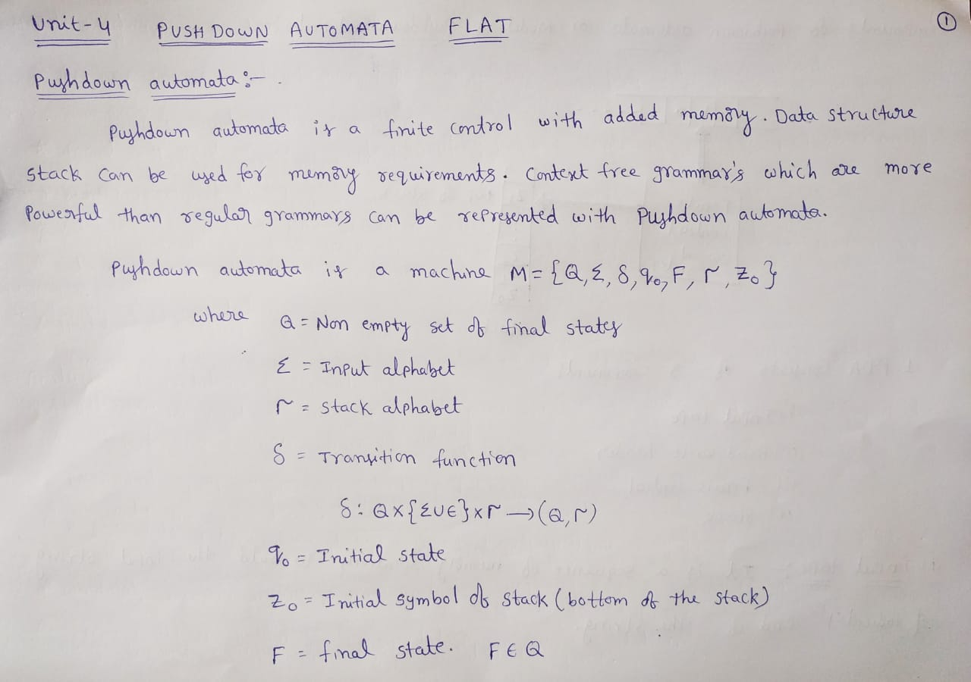

Slide 2
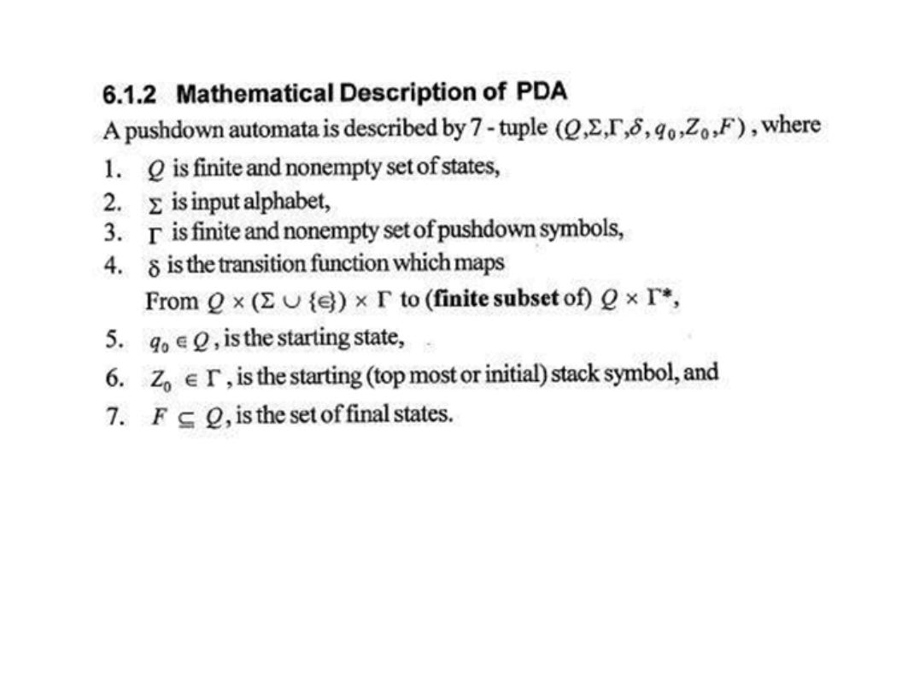

Slide 3
Finite Automata (FA)
Finite set of states
is in exactly one state at a time
CONTROL
UNIT
Start state
Final state(s)
TAPE
HEAD
Move to the right one cell at a time
INPUT TAPE
Store input of the DFA
Can be of any length

Slide 4
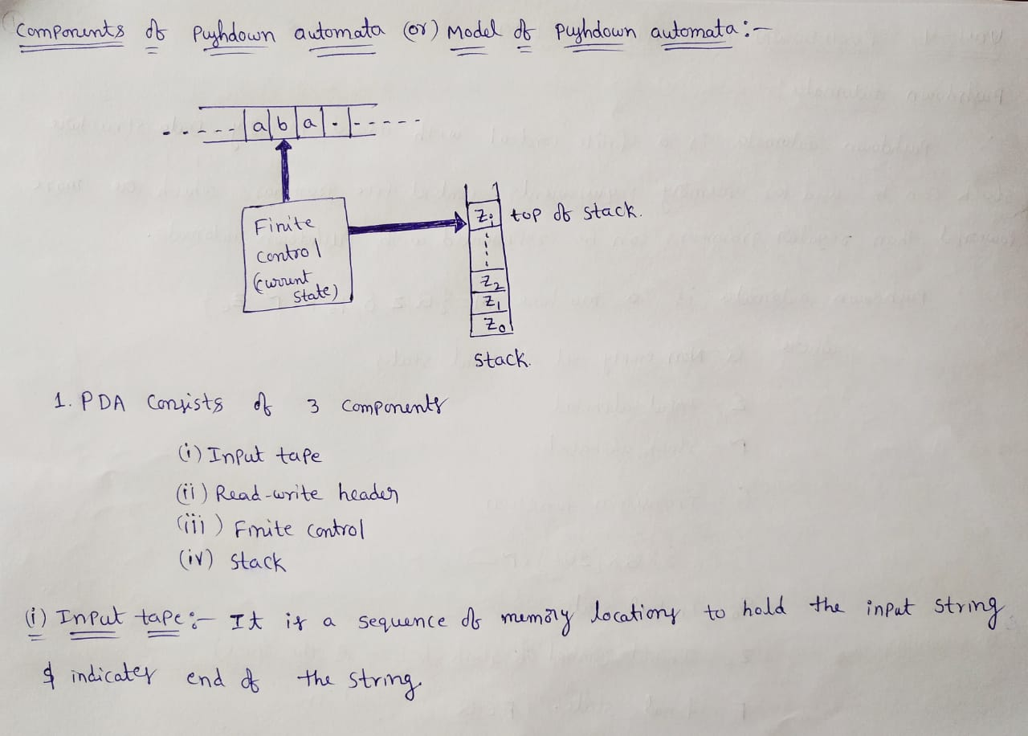

Slide 5
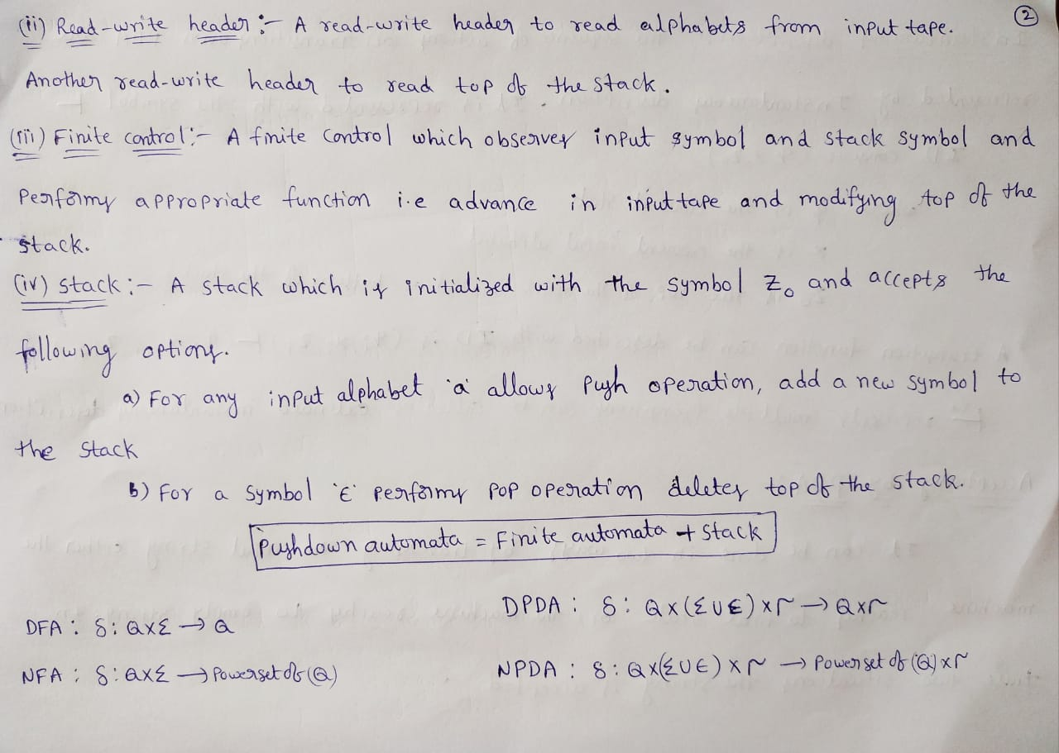

Slide 6
PDA as a state diagram
δ(q_{i},a, X)={(q_{j},Y)}
Next input symbol
Current
stack top
Stack
Top
Replacement
(w/ string Y)
Current state
a, X / Y
Next state
q_{i}
q_{j}

Slide 7
PDA’s Instantaneous Description (ID)
A PDA has a configuration at any given instance: (q,w,y)
q - current state
w - remainder of the input (i.e., unconsumed part)
y - current stack contents as a string from top to bottom of stack
If δ(q,a, X)={(p, A)} is a transition, then the following are also true:
(q, a, X ) |--- (p,ε,A)
(q, aw, XB ) |--- (p,w,AB)
|--- sign is called a “turnstile notation” and represents one move
|---* sign represents a sequence of moves

Slide 8
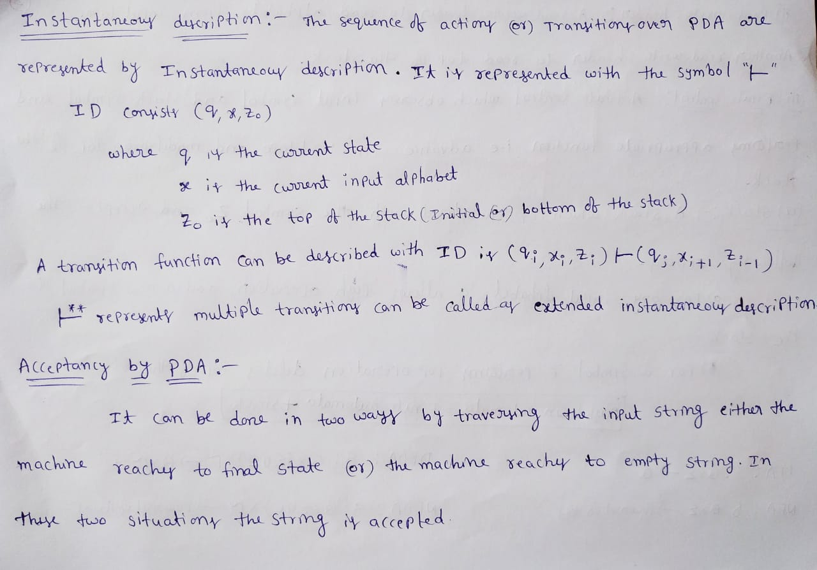

Slide 9
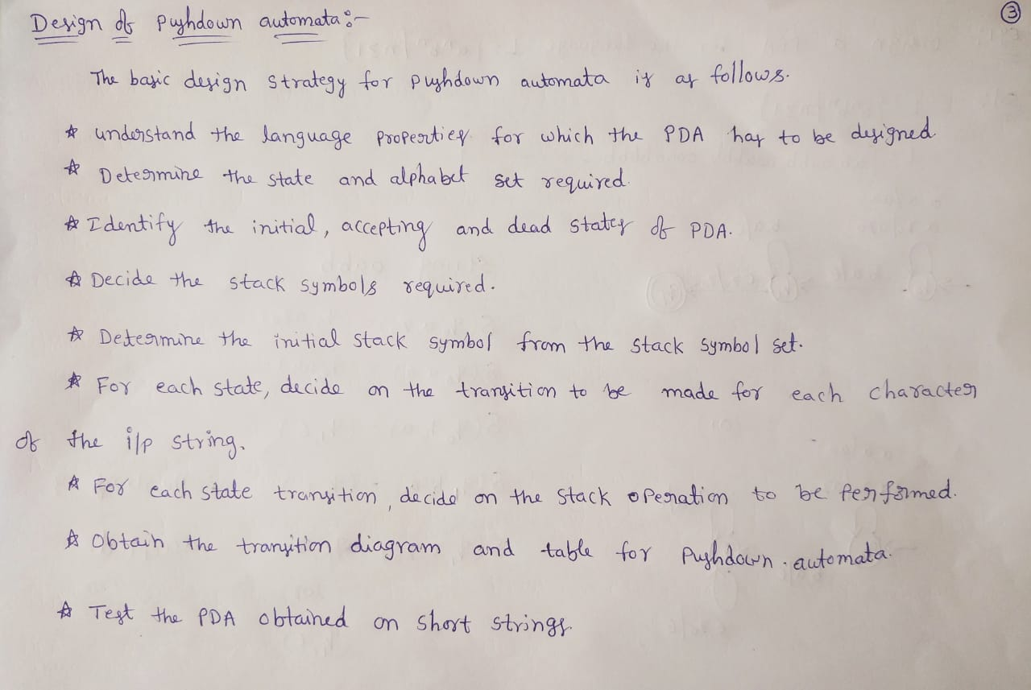

Slide 10
PDA as a state diagram
δ(q_{i},a, X)={(q_{j},Y)}
Next input symbol
Current
stack top
Stack
Top
Replacement
(w/ string Y)
Current state
a, X / Y
Next state
q_{i}
q_{j}

Slide 11
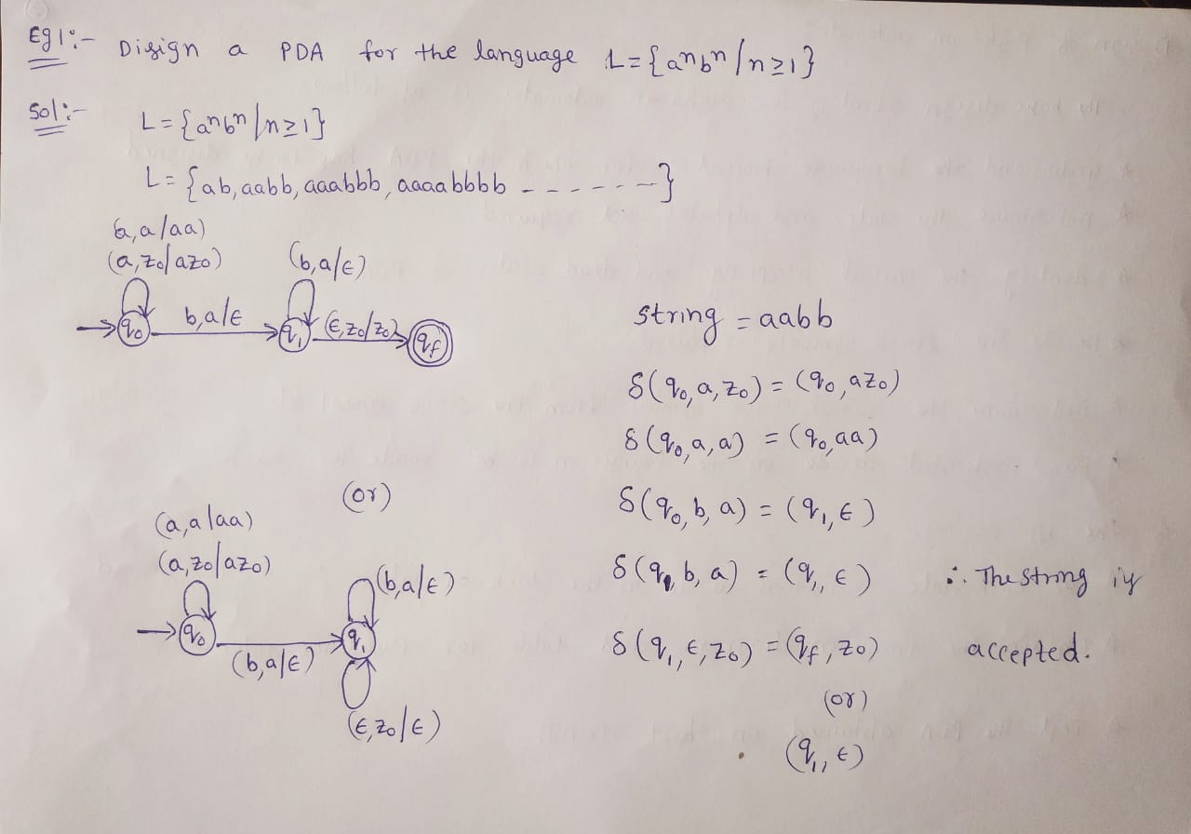

Slide 12
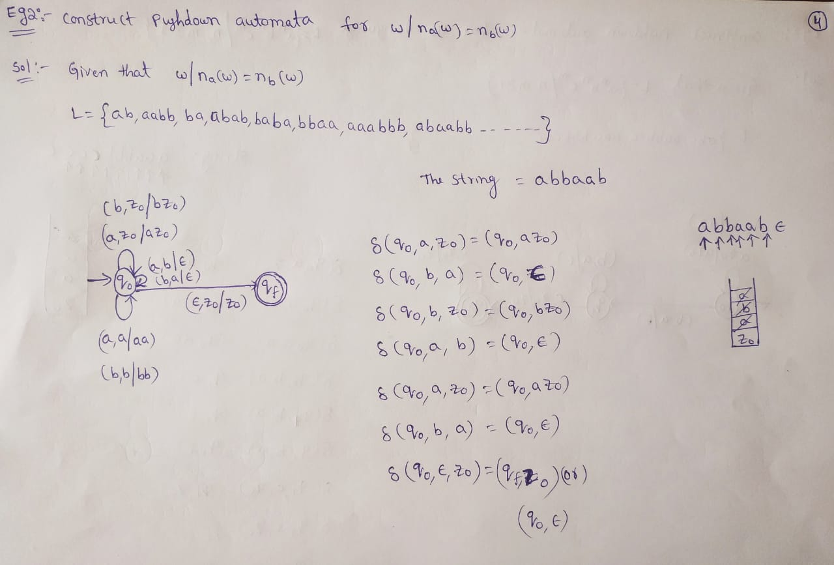

Slide 13
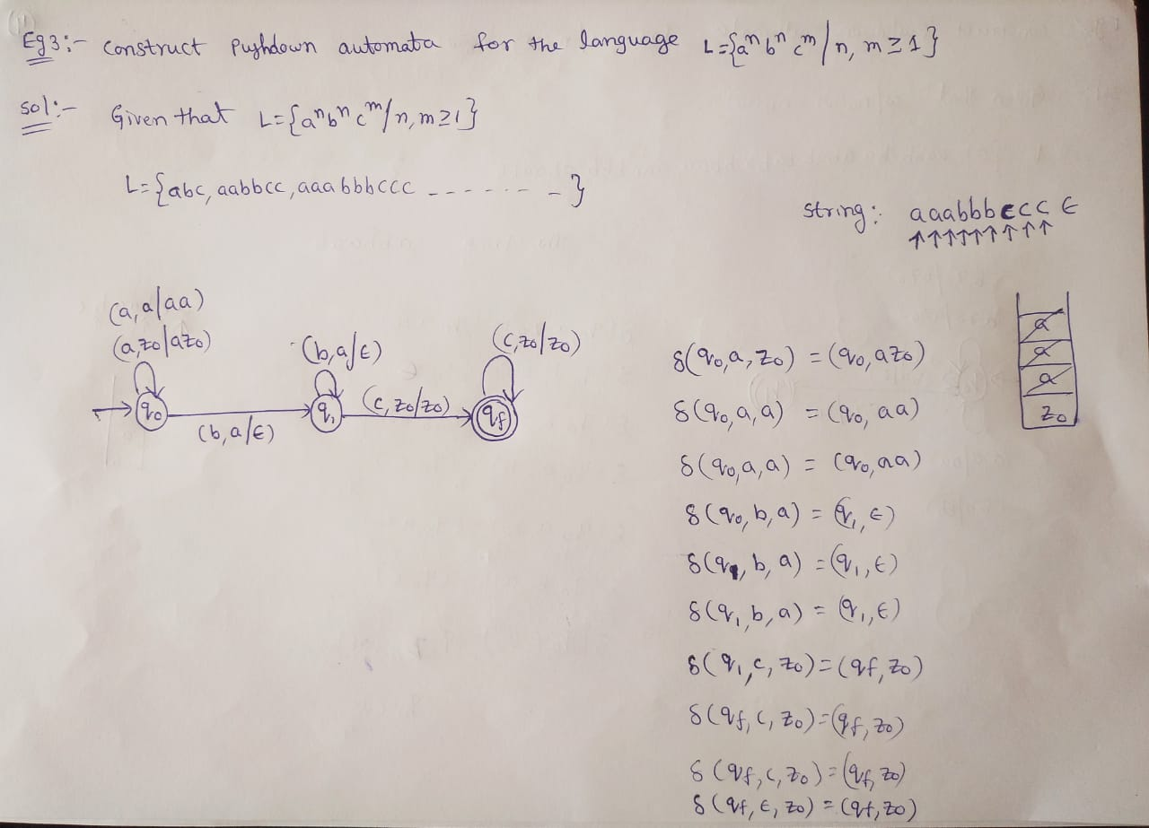

Slide 14
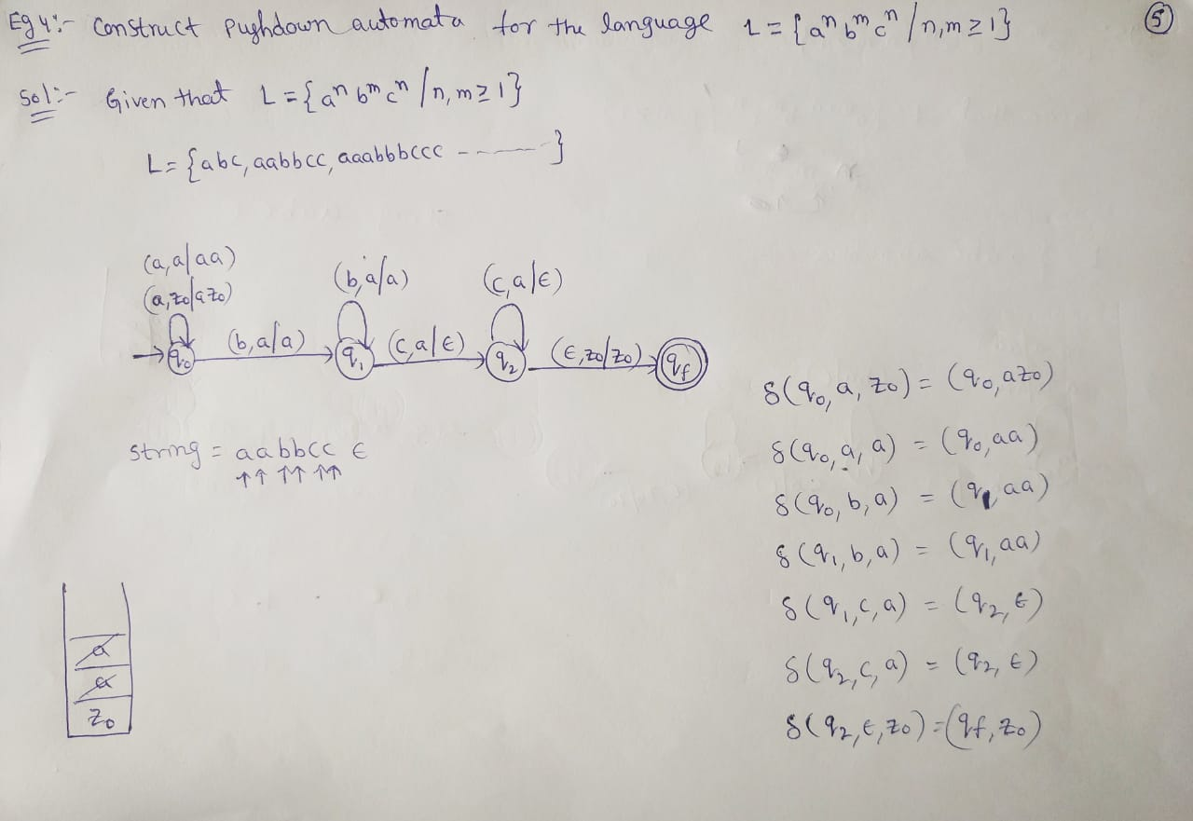

Slide 15
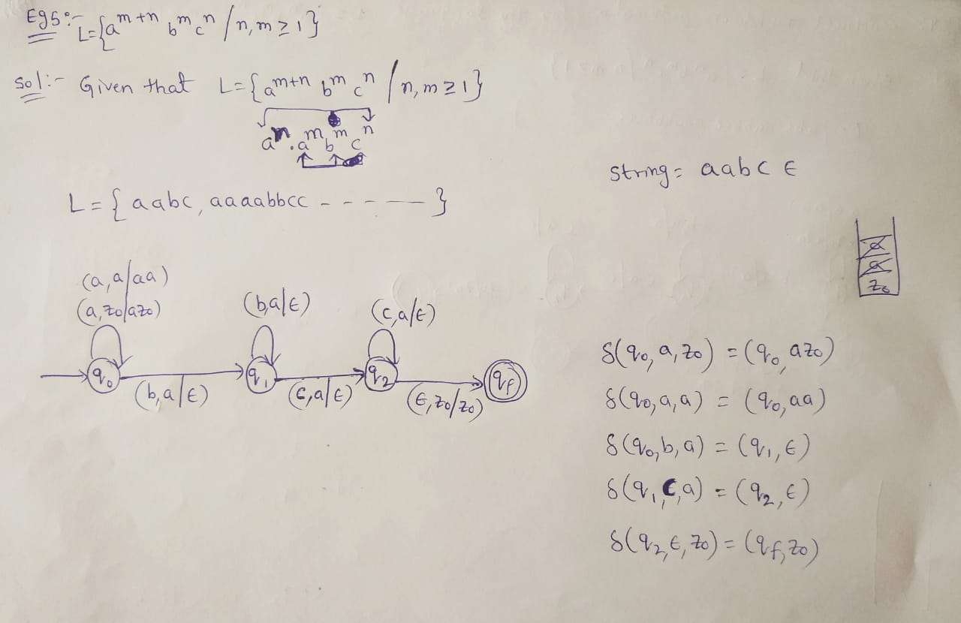

Slide 16
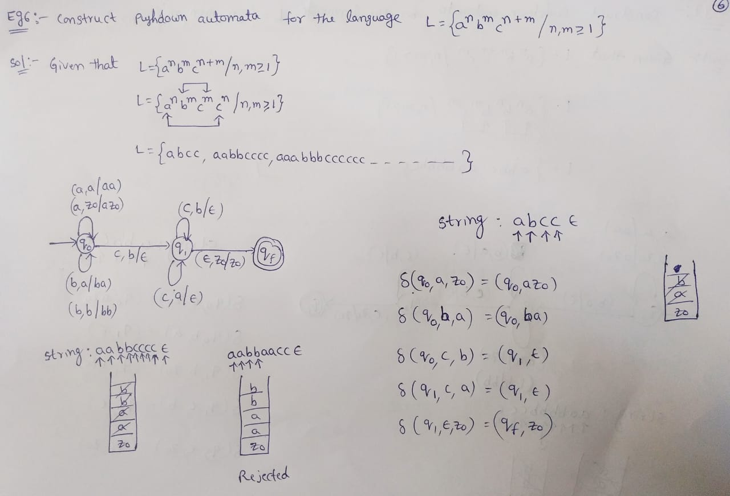

Slide 17
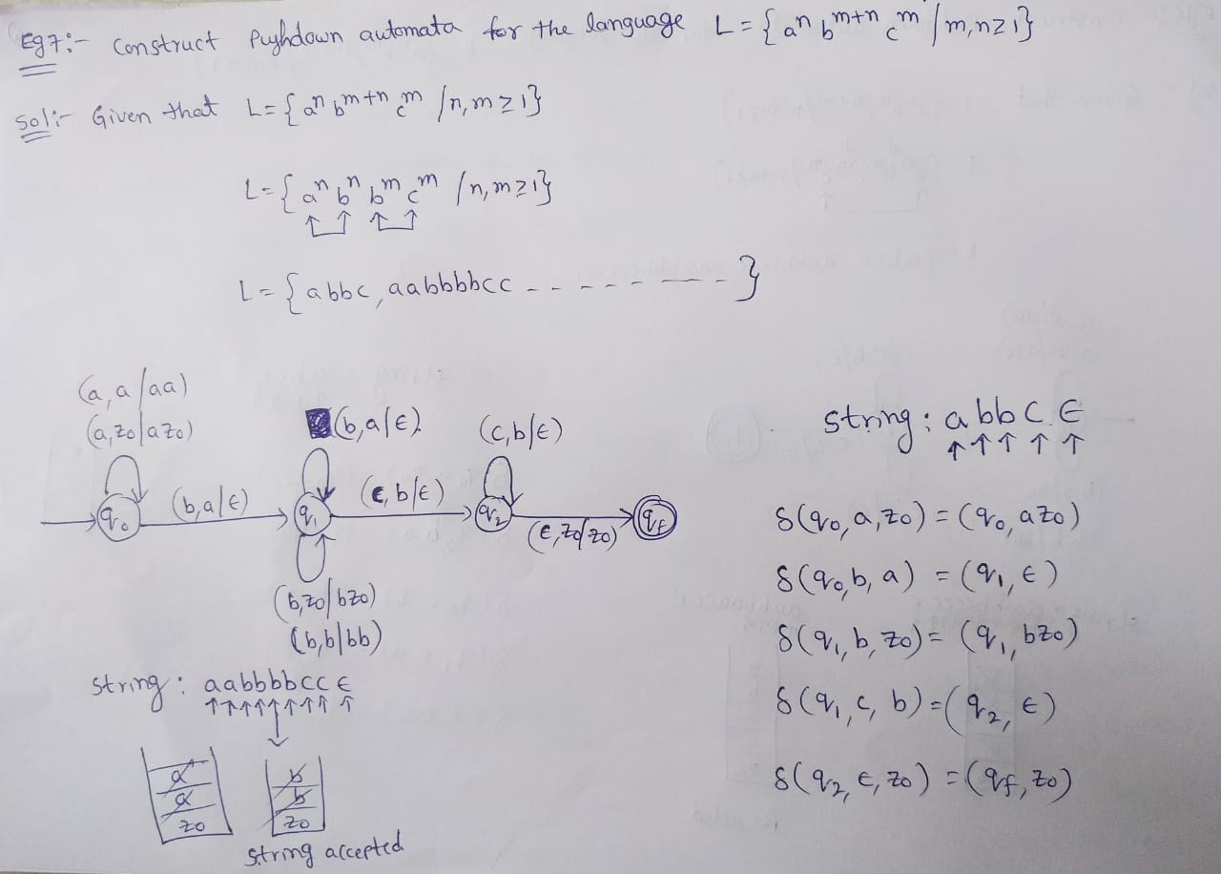

Slide 18
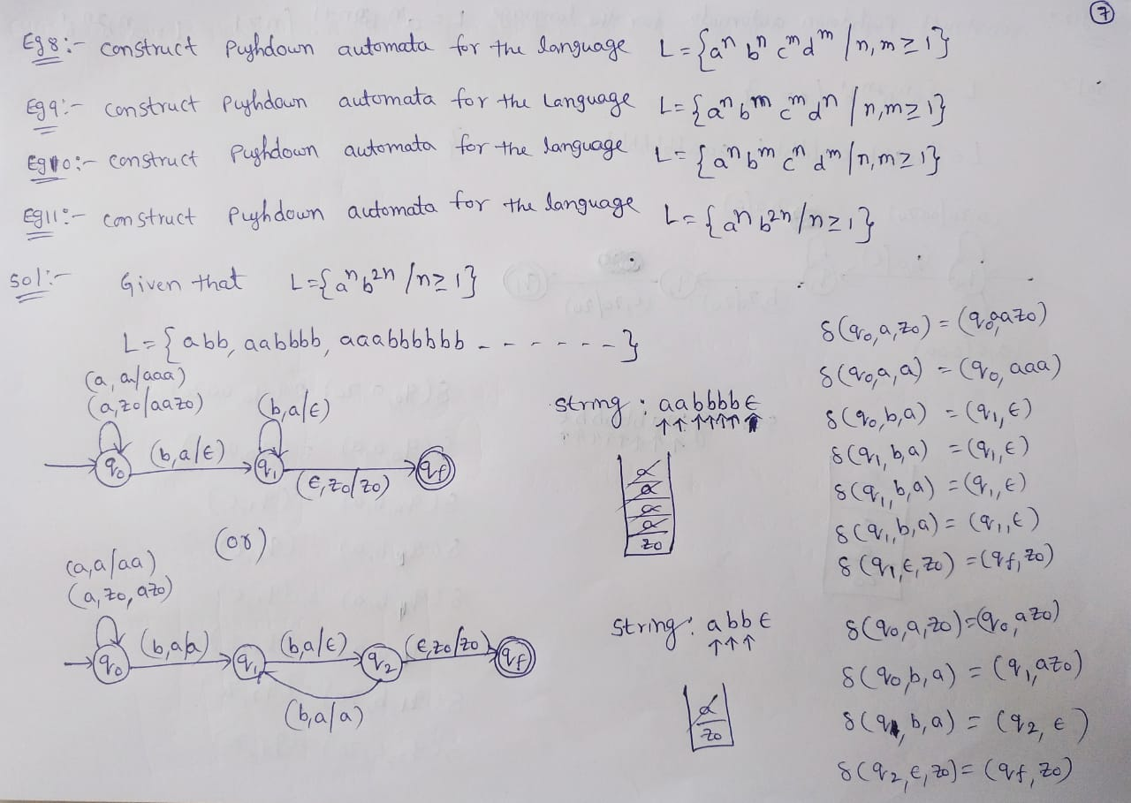

Slide 19
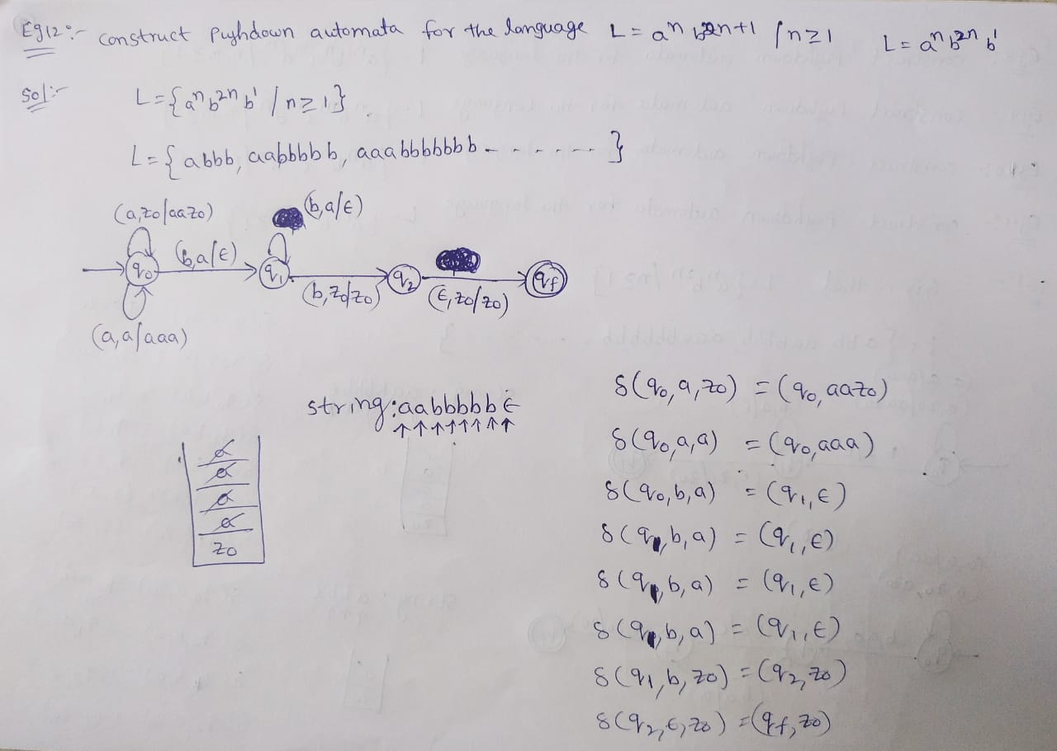

Slide 20
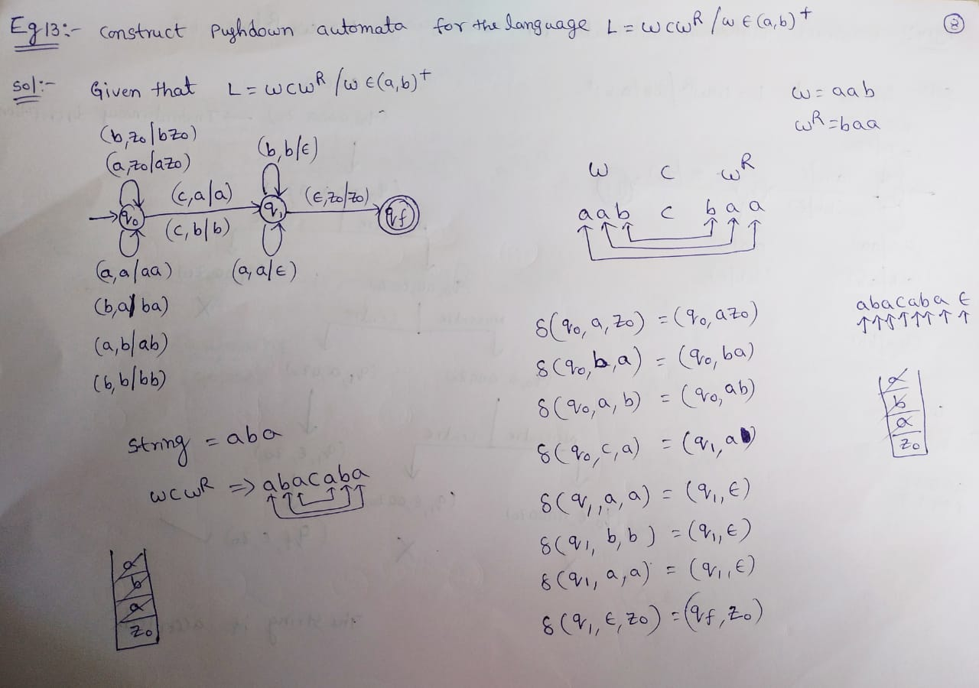

Slide 21
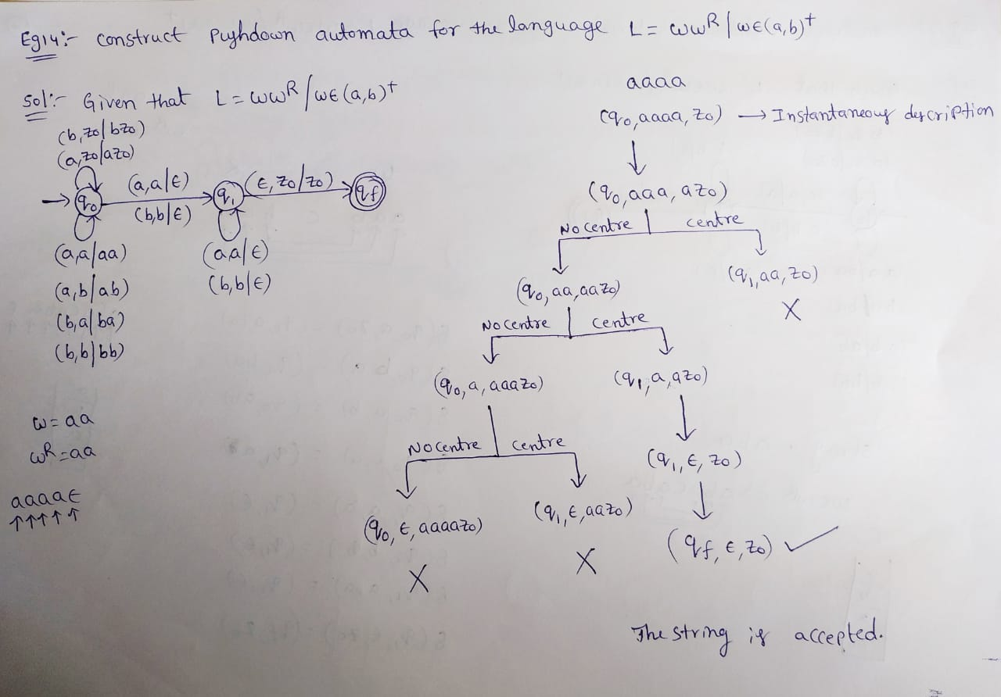

Slide 22
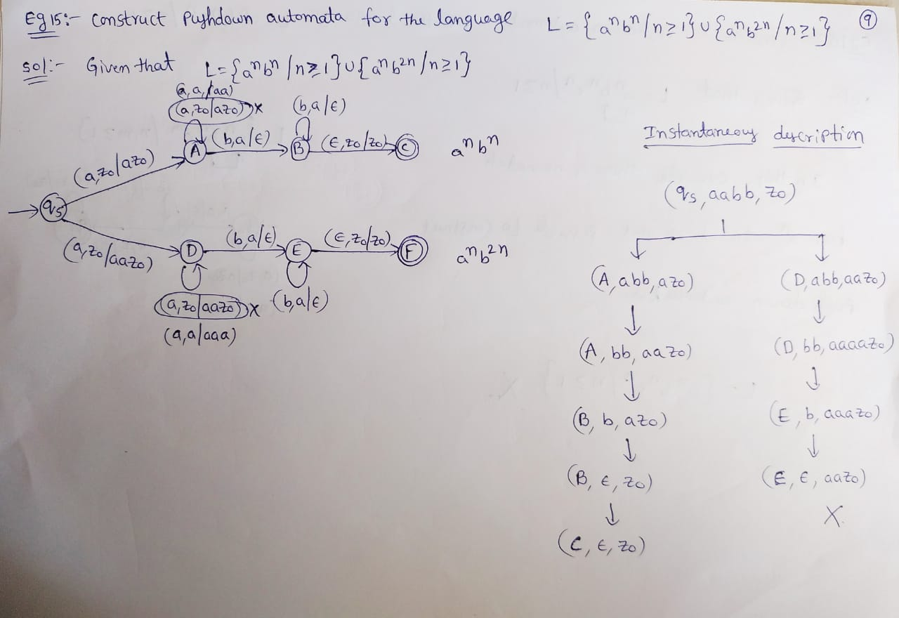

Slide 23
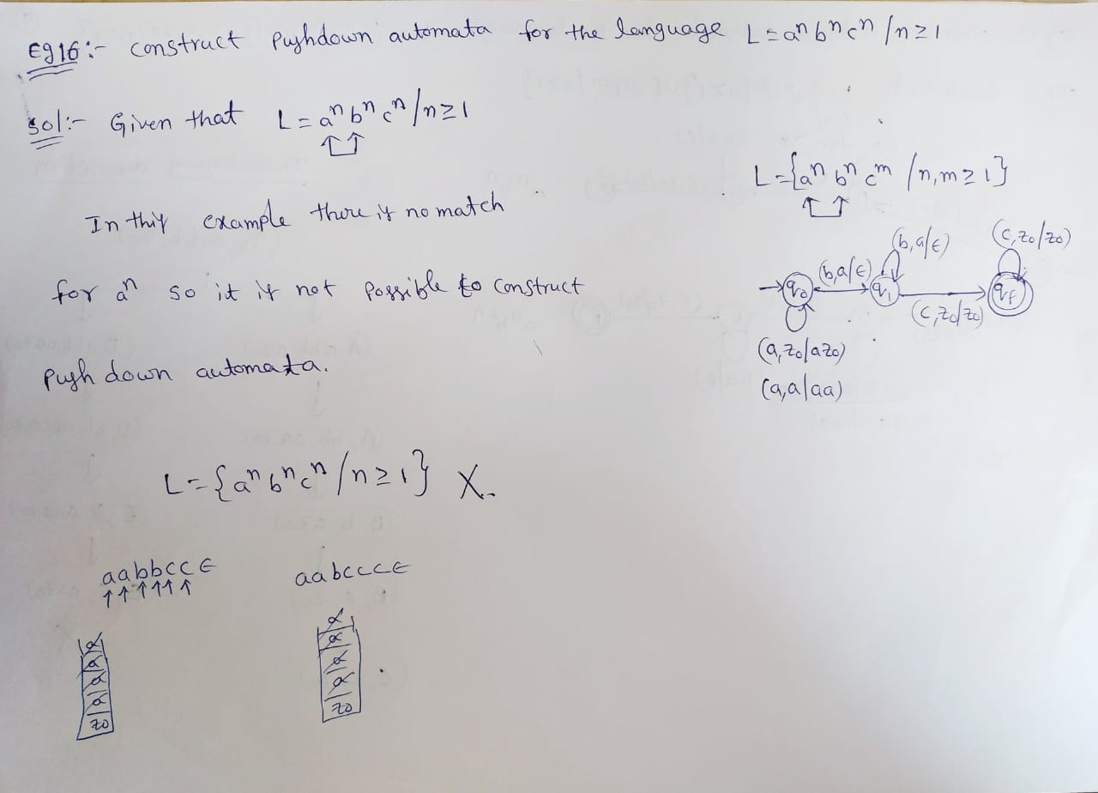

Slide 24
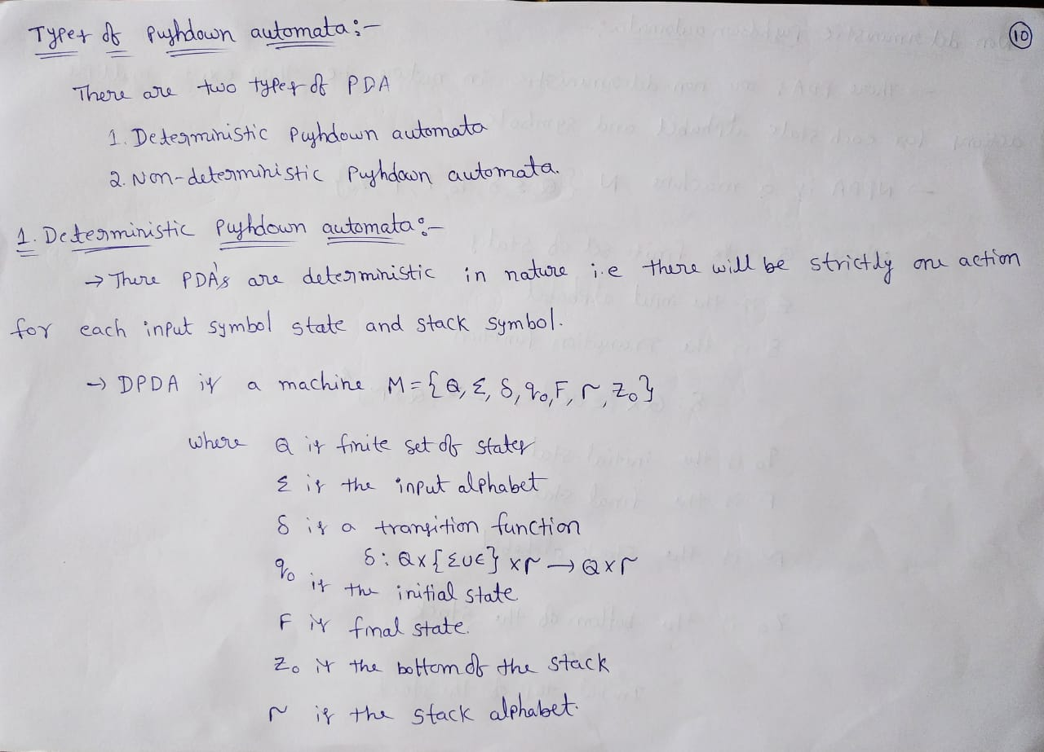

Slide 25
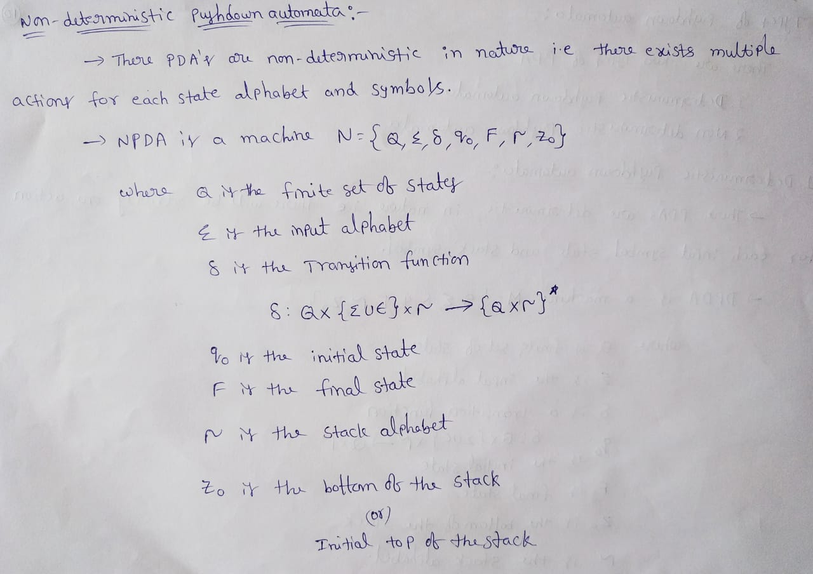

Slide 26
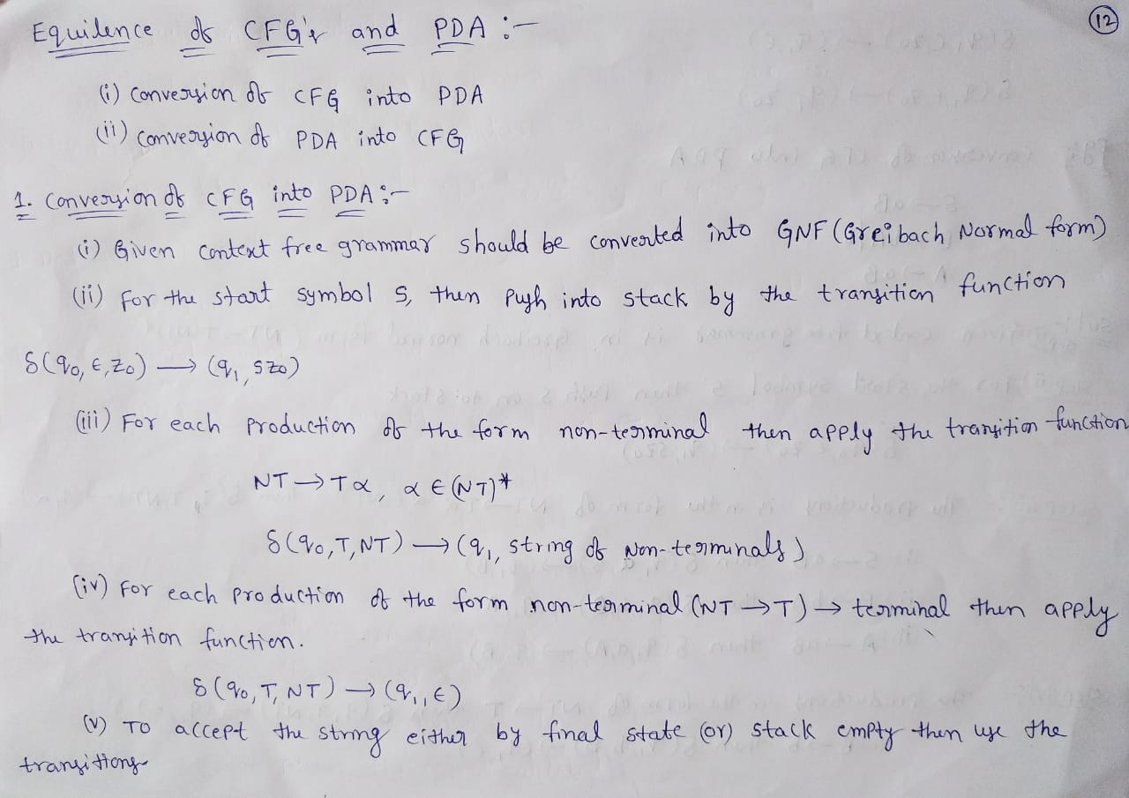

Slide 27
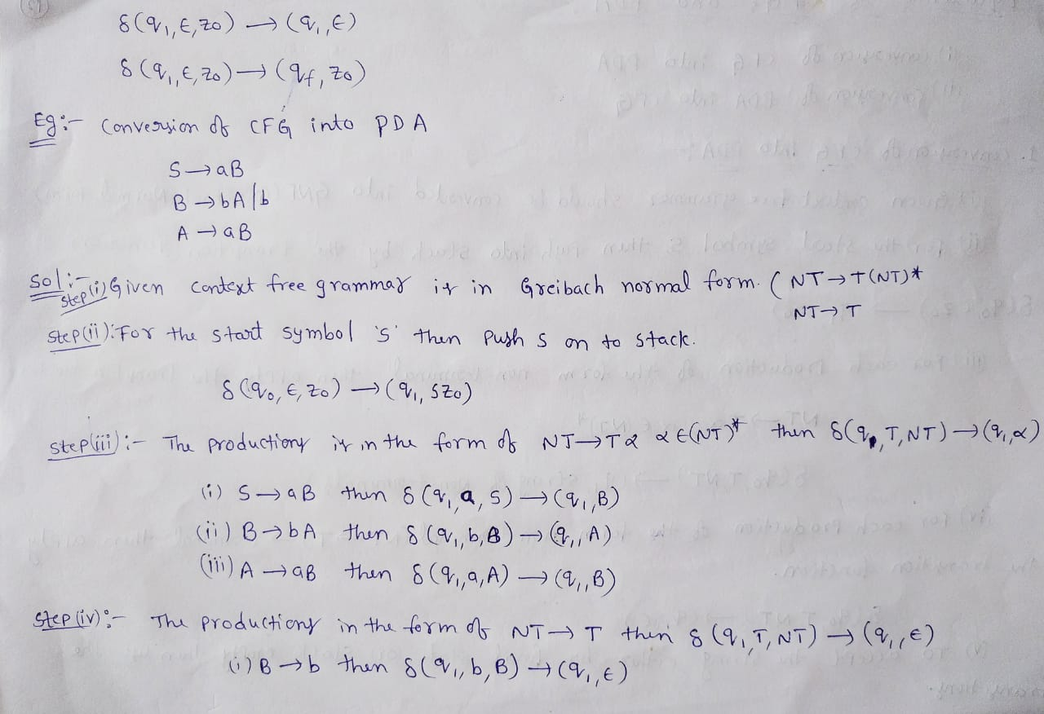

Slide 28
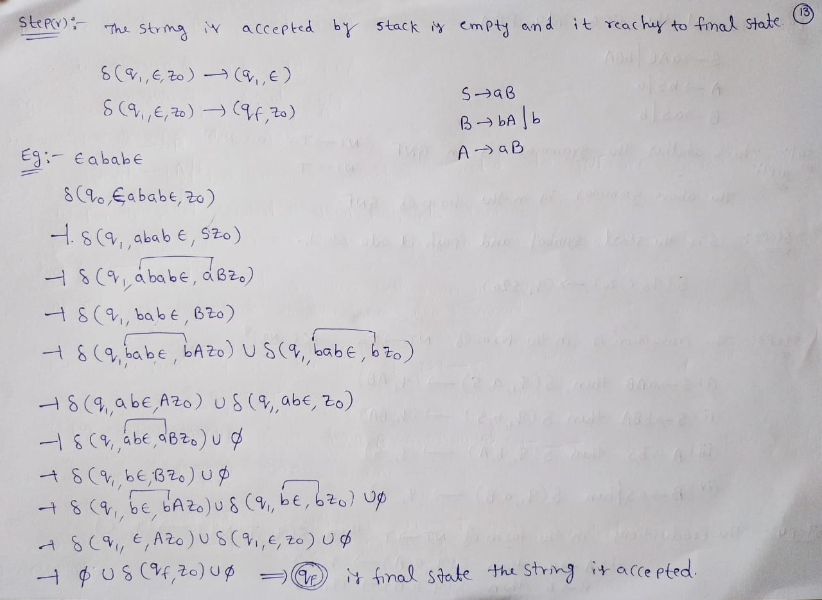

Slide 29
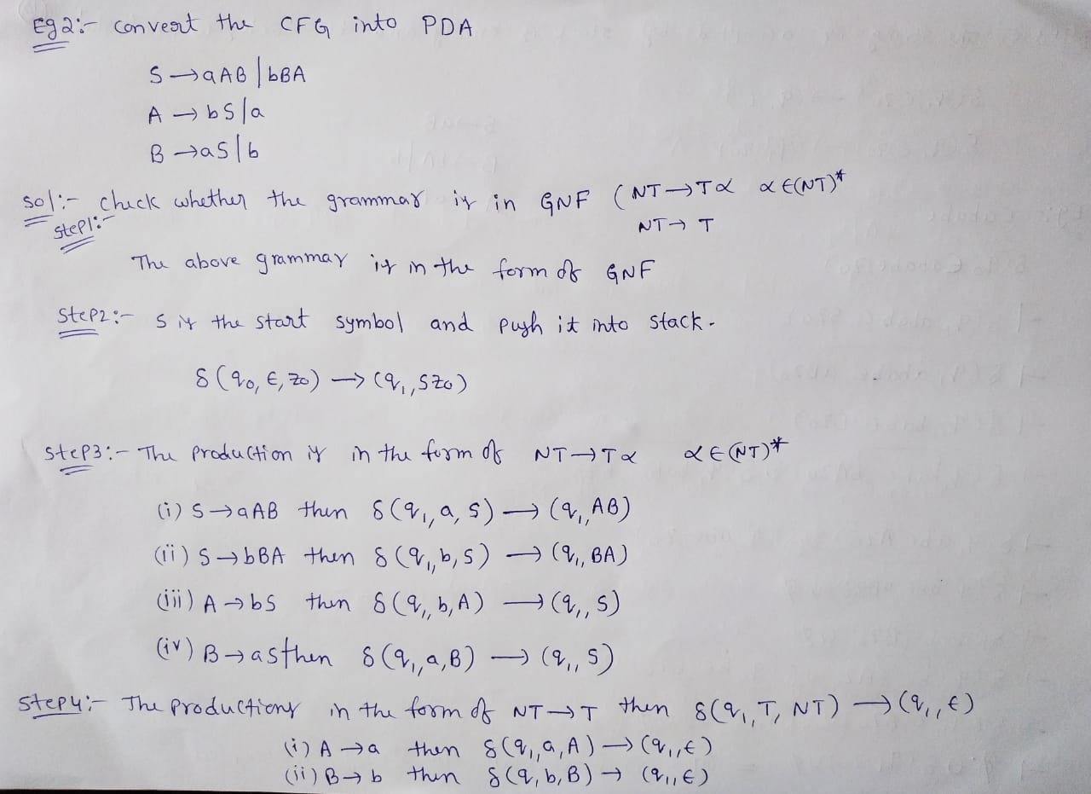

Slide 30
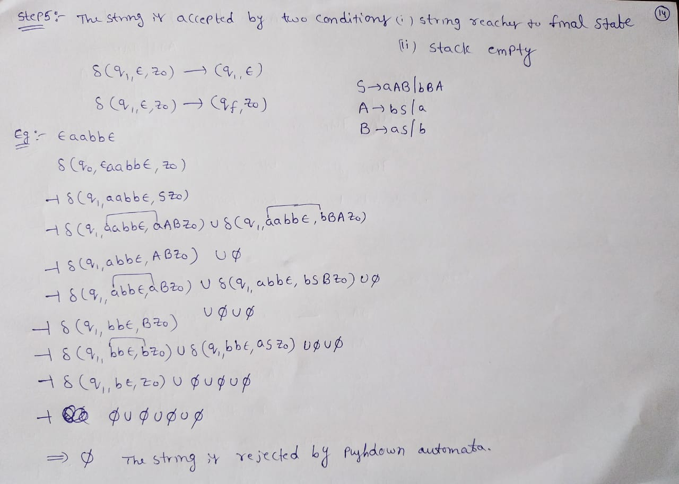

Slide 31
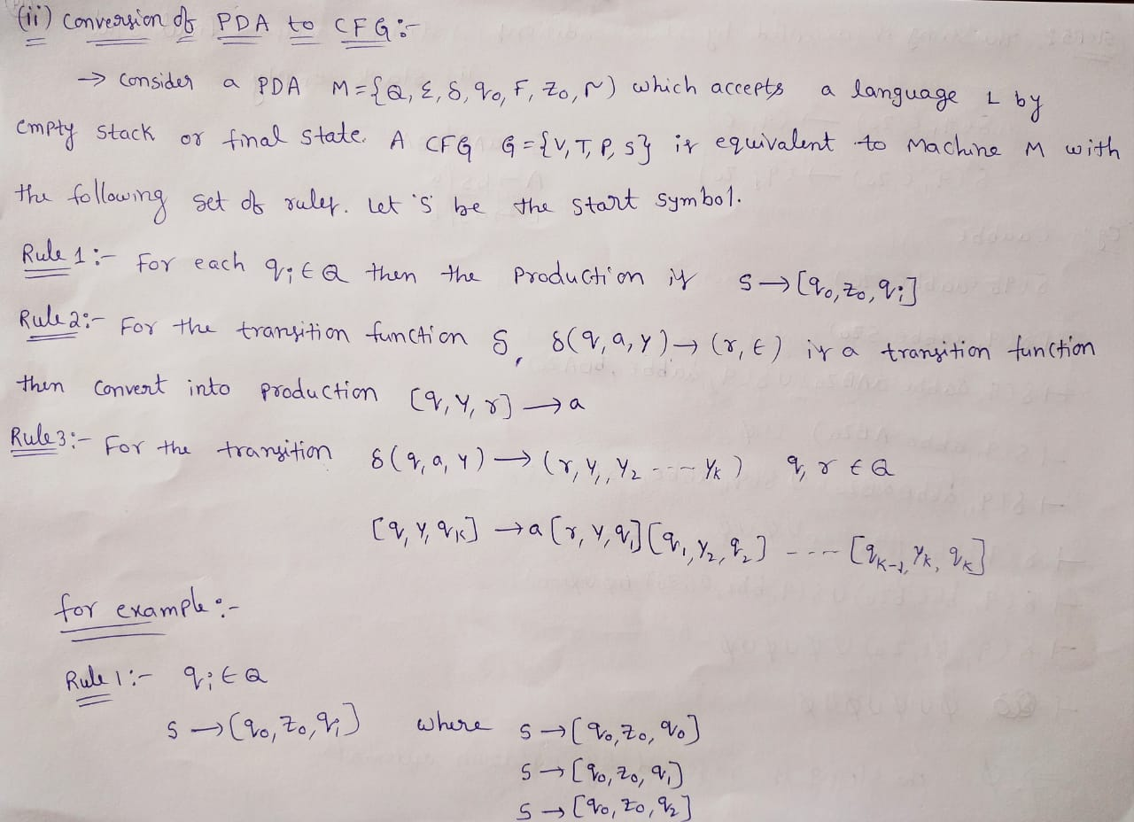

Slide 32
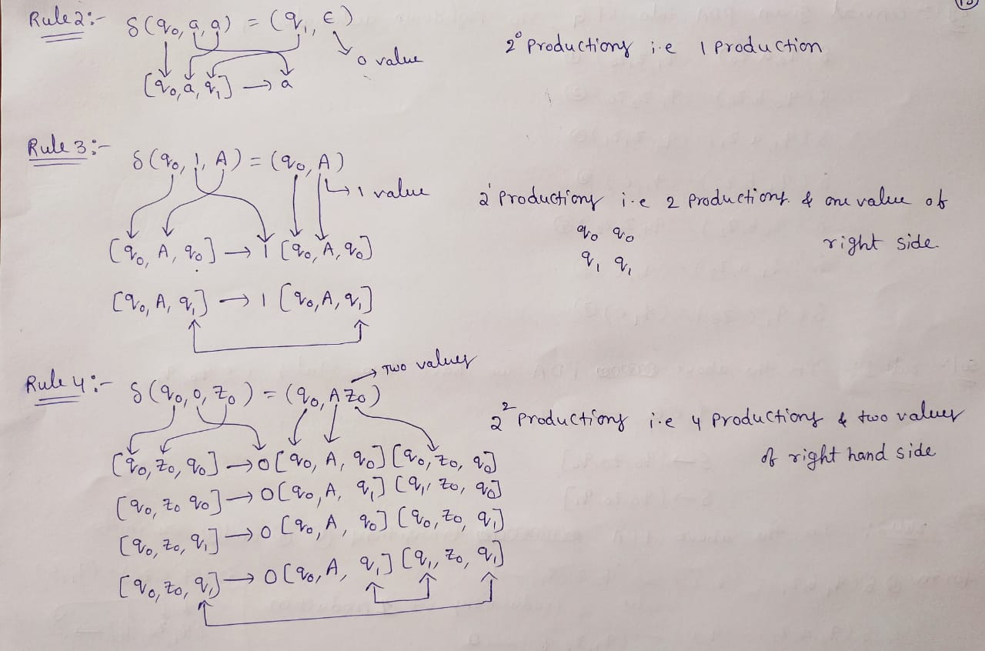

Slide 33
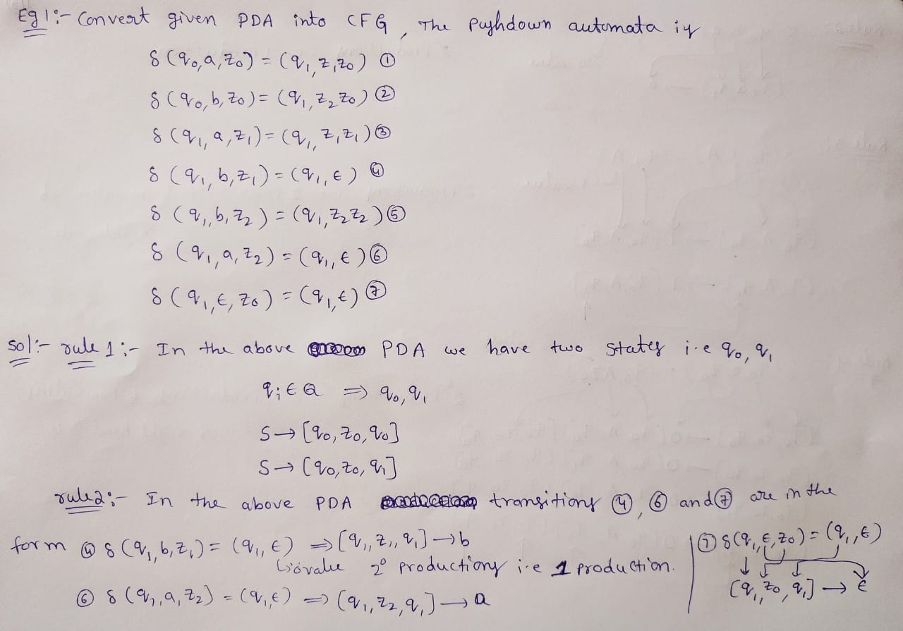

Slide 34
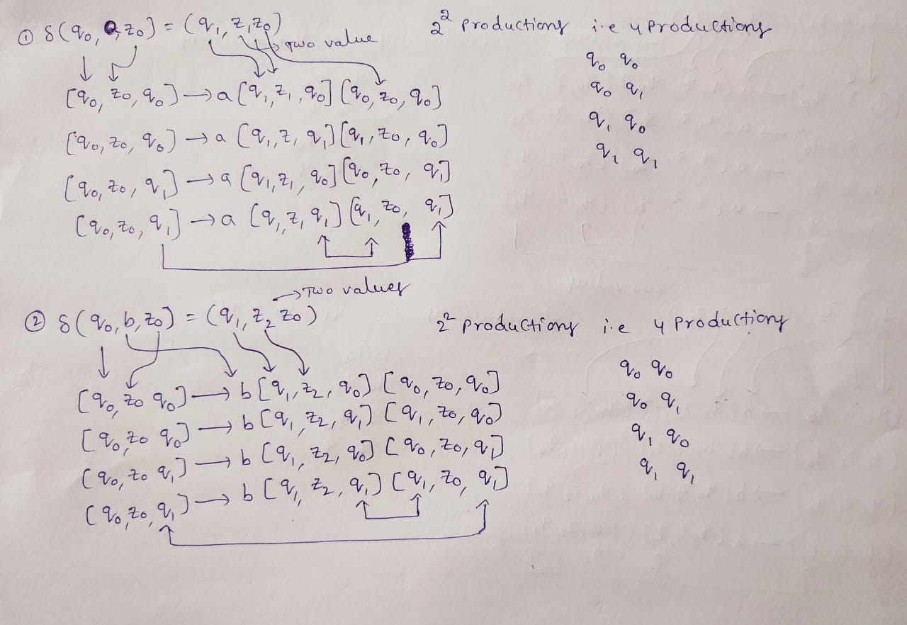

Slide 35
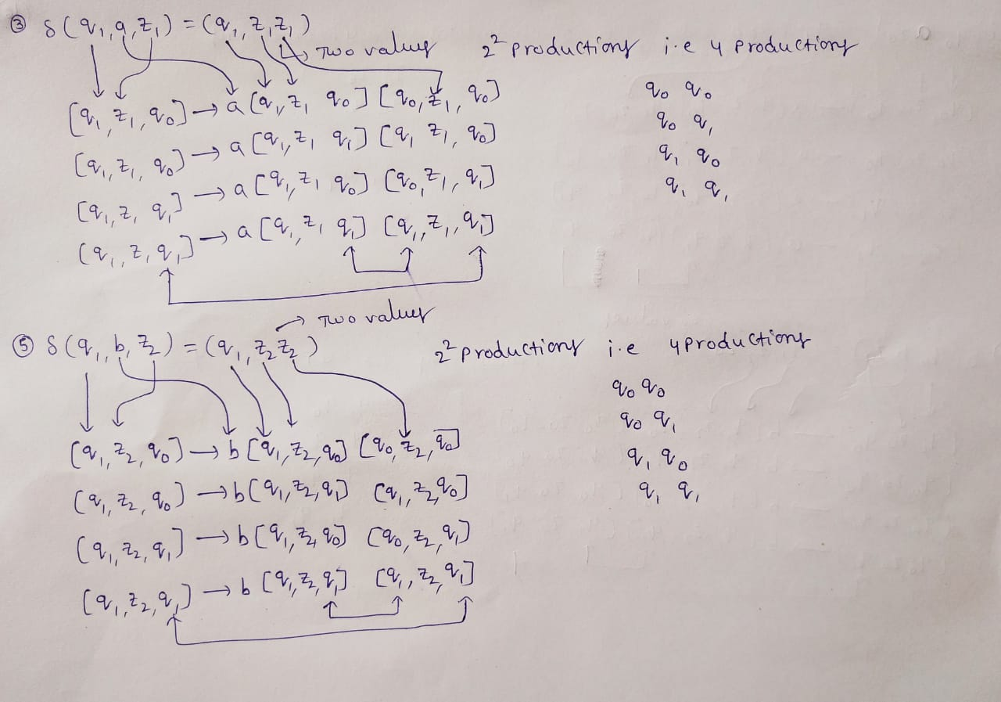

Slide 36
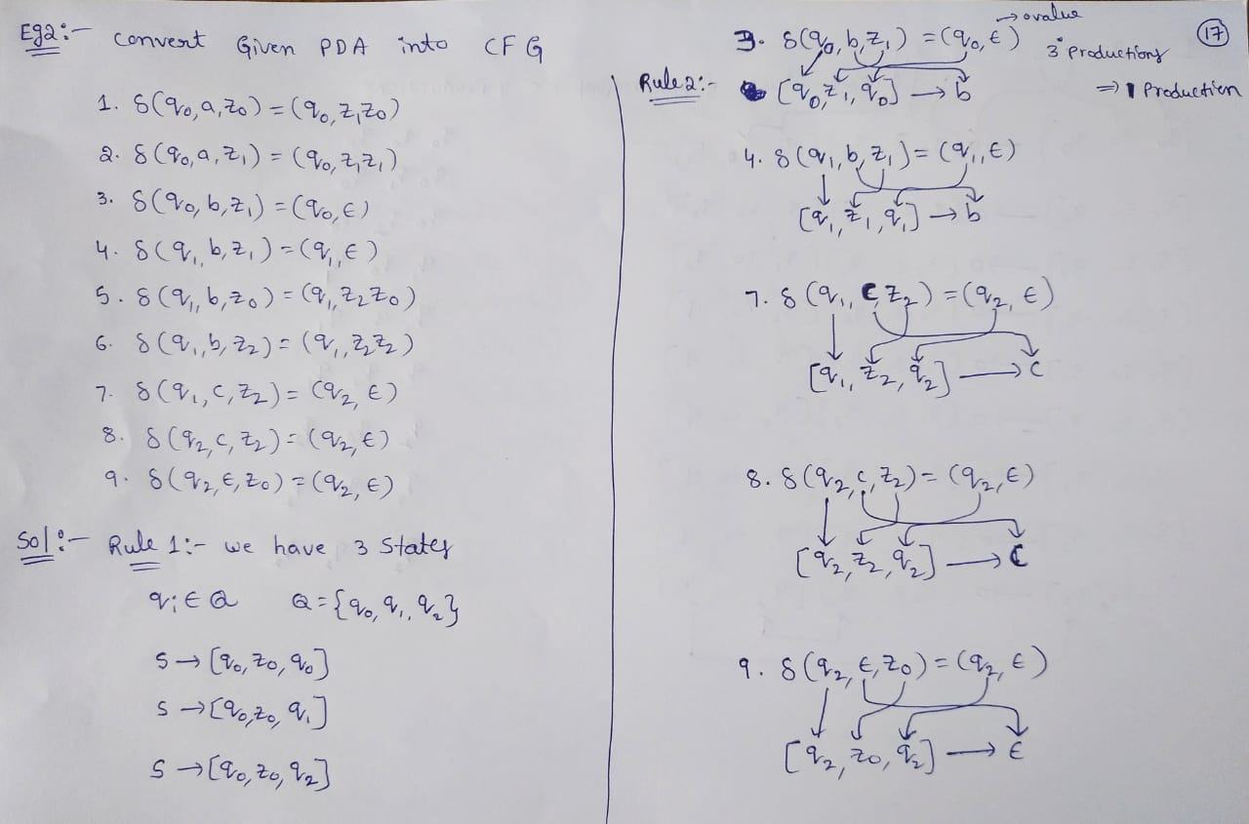

Slide 37
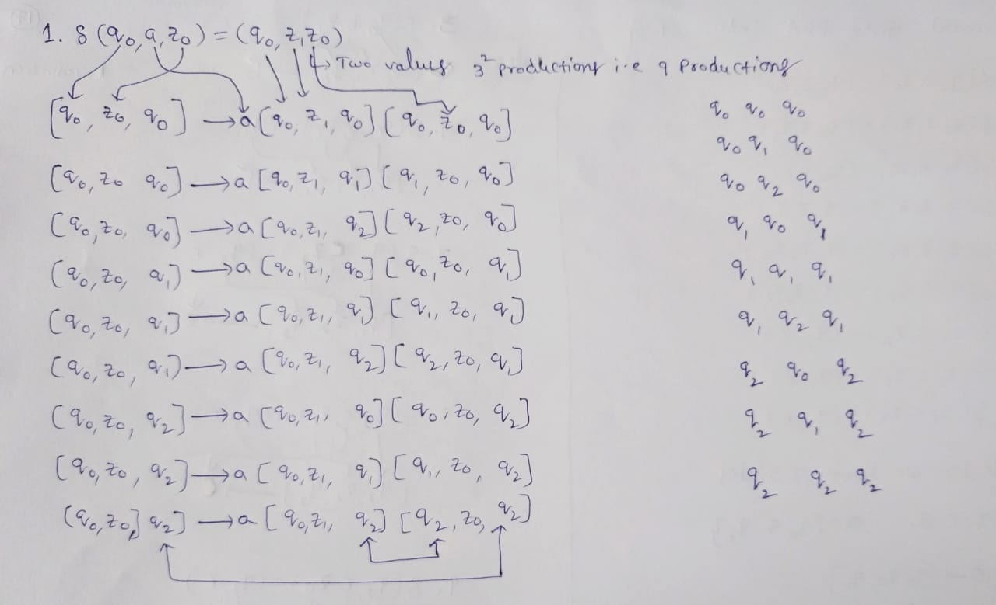

Slide 38
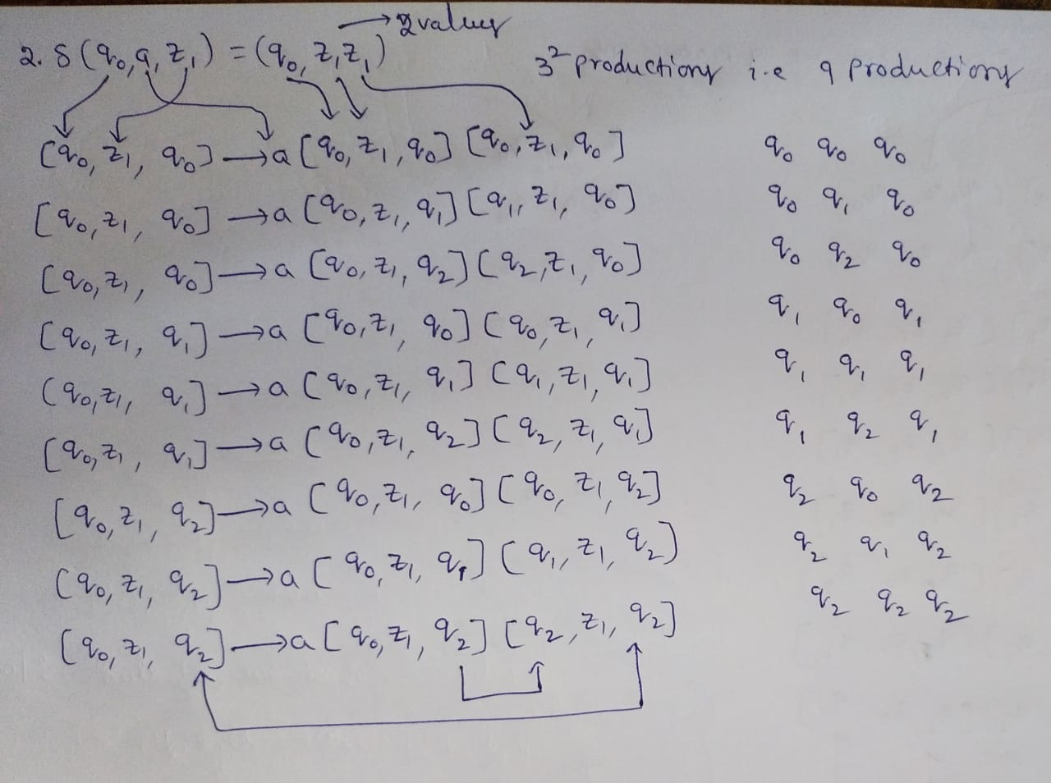

Slide 39
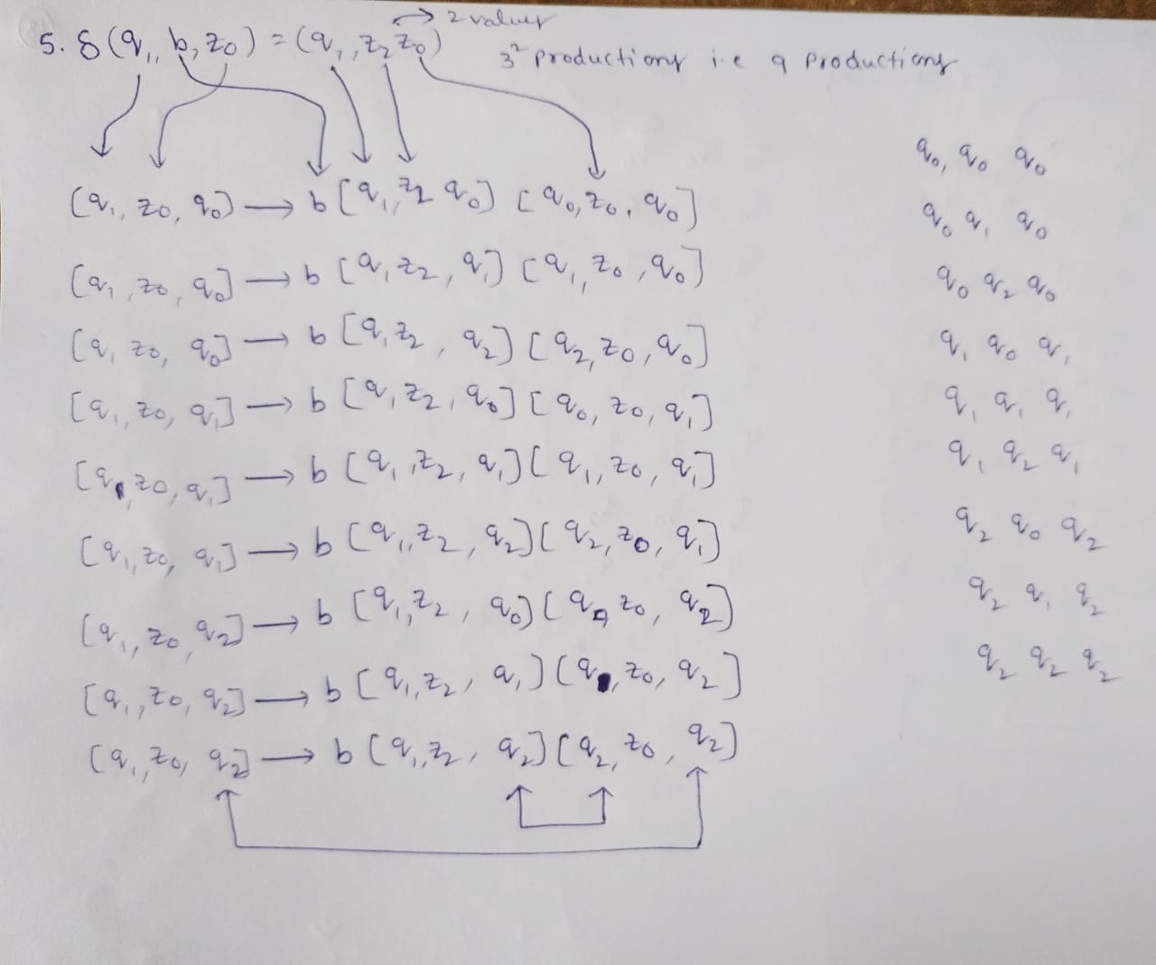

Slide 40
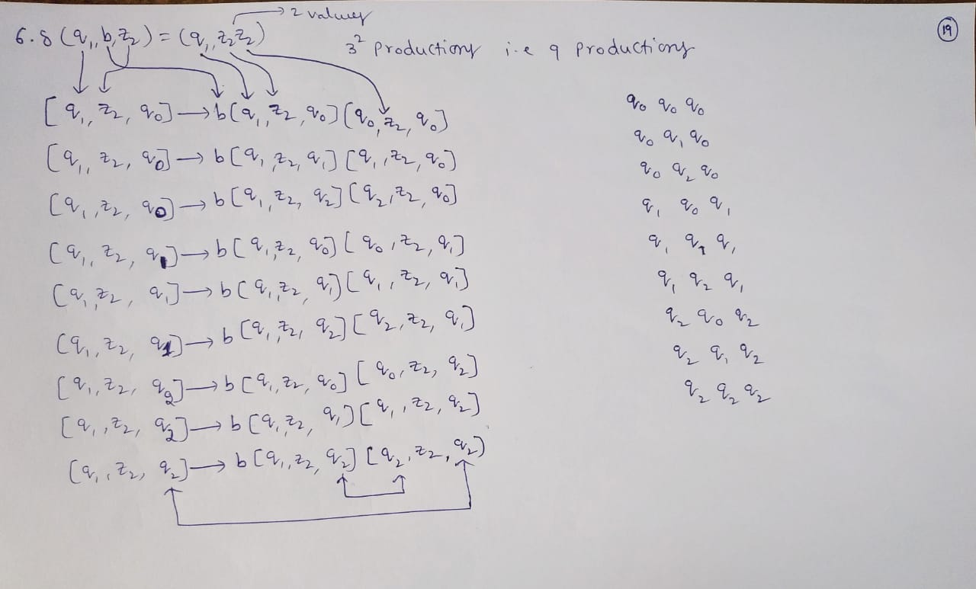

Slide 41
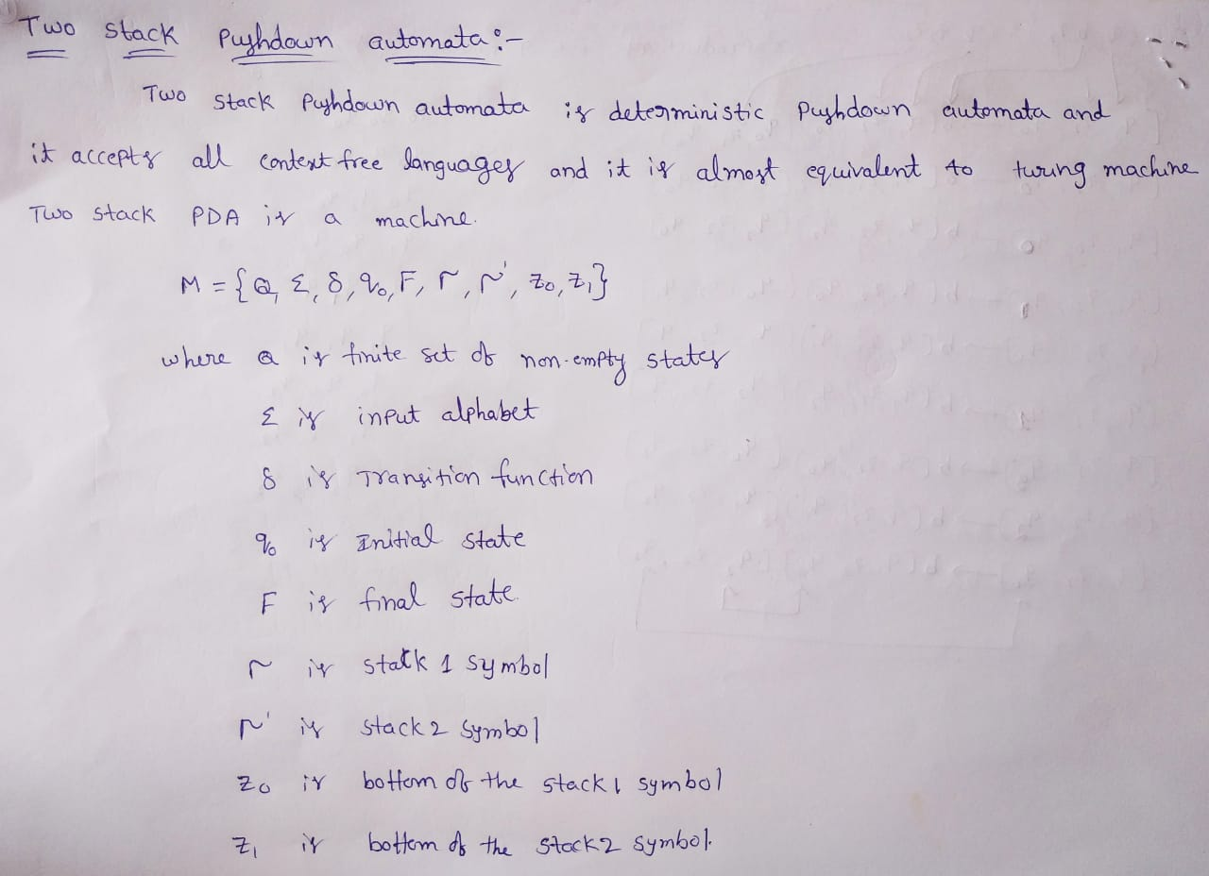

Slide 42
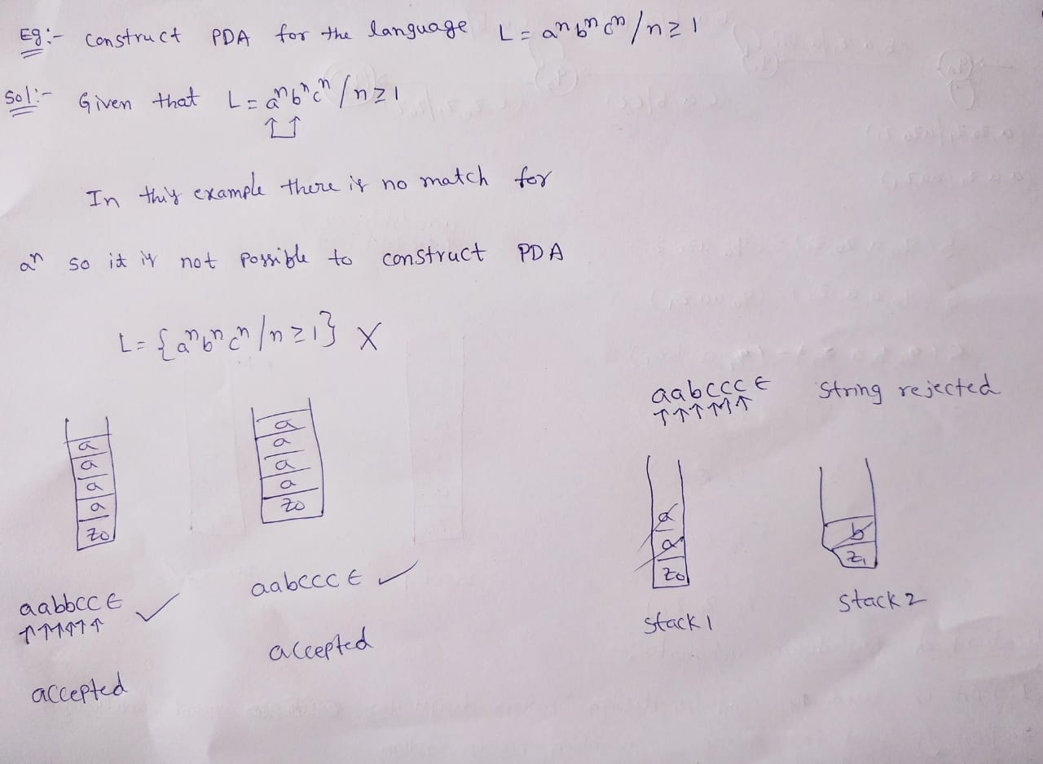

Slide 43
